Slide 1
TYPES OF COLLAGE
PRESENTED BY S.MUKILAN

Slide 2
TYPES OF COLLAGE
Vocational school
Private university
Pubilc university
Distance education
university National
Nursing school
Virtual university
Residential collage

Slide 3


Slide 4
COLLAGE FACILITES
Collage Hostel separate hostel facility are provided for boys and girls in collage campus
Transport Facility
Cafeteria
Labrary& information center
Collage canteen
Internet center

Slide 5

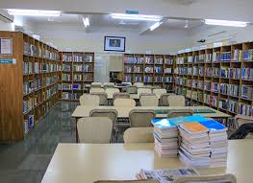
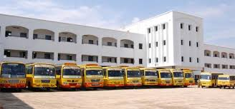

INFRASTRUCTURE OE COLLAGE

Slide 6
TYPES OE COLLAGE
AUTONOMOUS
NON-AUTONOMOUS

